Slide 1


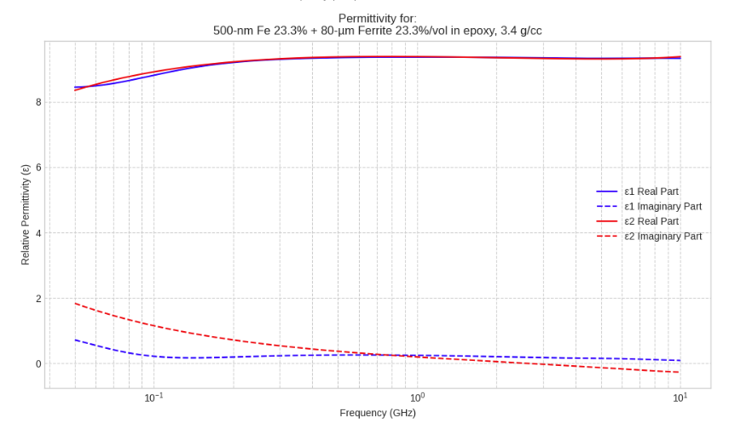
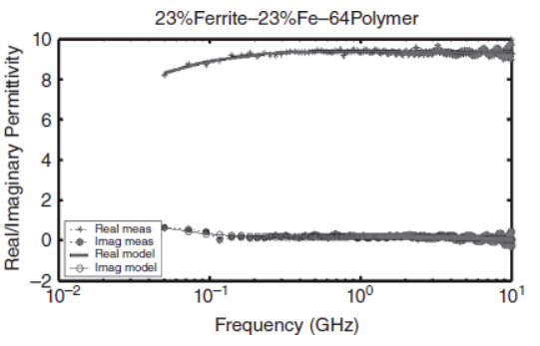
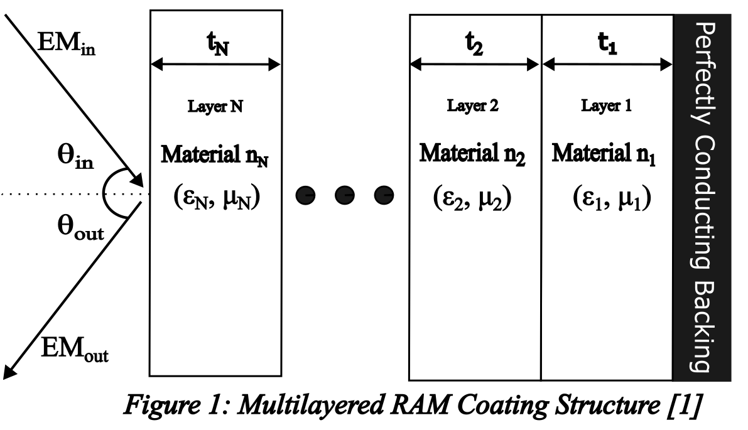
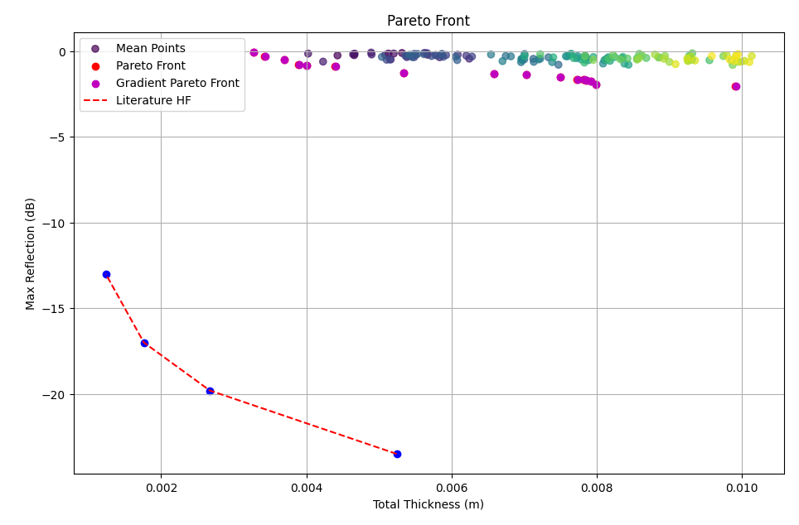
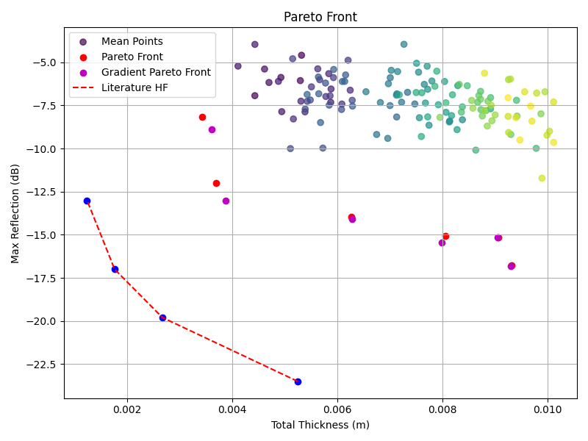

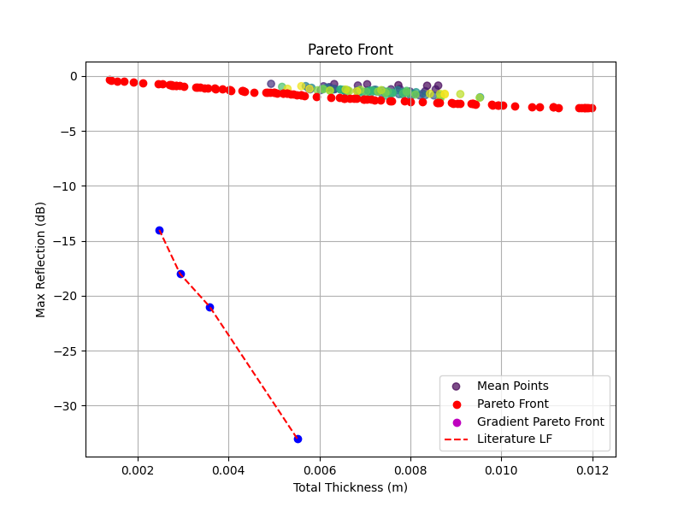
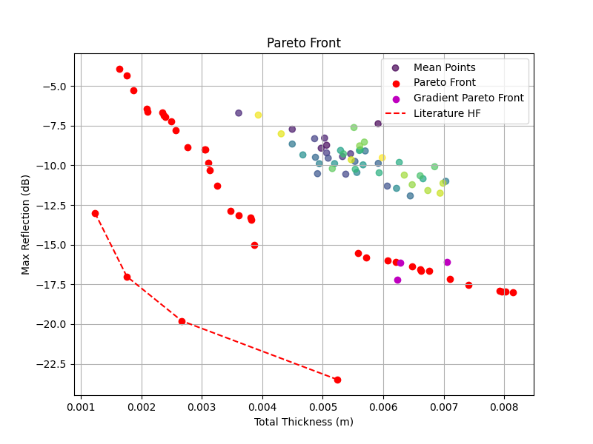
Design of 1D Graded Lightweight Broad-Band Microwave Absorbers
Project Engineers: Ethan Smelko, Joshua Puerzer, Patrick Schneider, Daniel Glazer, Joe Altvater, Daniel Giganti Dima
Sponsors: Dr. Paul Leu, DEVCOM Army Research Laboratory
Project Description
Design Process
Real Material Implementation
Goal: Create a hybrid optimization framework to optimize the design of multi-layer Radar Absorbing Materials (RAM) for stealth applications.
Optimization Techniques:
We utilized both a Genetic Algorithm (GA) and Bayesian Optimization (BO) with a Gaussian Process and Tree-Structure Parzen Estimator. The framework's accuracy is validated through a multi-step process. Our primary validation metric involves plotting our absorption vs. thickness curves against Michielssen's established Pareto frontier to visually and mathematically examine our results. We also performed a comparative internal analysis by comparing the optimized structures from our BO and GA methods; if both algorithms arrive at similar conclusions, we can infer that this is a near-optimal structure.
The Design was created using optimization methods in Python to include both the Michielssen material database and the Real material database. These optimizations included Genetic Algorithm (GA) and Bayesian Optimization (BO) to optimize material selection, and Gradient Descent (GD) for thickness optimization. A Pareto front objective was used to evaluate optimizations for lowest thickness and lowest reflection.
To implement the real materials from the Electromagnetic Composites Handbook [2] a materials database was first created. First an automatic implementation with a python package pdfplumber; however, it yielded too many data inconsistencies with the time complexity. Ultimately, we decided to use a python dictionary which had a O(1) time complexity. The permittivity and permeability of the materials were needed for calculations, and these calculations were validated through comparing outputs to [2] graphs to the ones generated with the code.
Import Material Database
Optimize Materials Via GA/BO
Optimize Thickness Via GD
Display and Save Pareto Front
Gaussian-Bayesian Optimization Results
Genetic Algorithm Results
Fig 6: Python Code Generated Graph
Fig 7: Electromagnetic Composites Handbook [2], graph
Validation/Conclusions:
Metric | GA | BO
Gains <0dB
Real Materials Implemented
Algorithms Work on Multiple Machines
GA and BO Produce Similar Results
Benchmark Paper Beaten | In-Progress / Future Work | In-Progress / Future Work
Objectives
For a RAM, optimization occurs when reflection is minimized and absorption is maximized. This principle was our primary objective in all aspects of the project.
Objective 1:
Implement real electromagnetic materials into the optimization algorithms [2].
Objective 2: Explore new optimization techniques to improve the Michielssen [1] results
Objective 3: Implement a fill factor parameter to further reduce reflection
Fig 2: LF Gaussian-Bayesian Optimization Results
Fig 3: HF Gaussian-Bayesian Optimization Results
Acknowledgements:
We would like to sincerely thank Dr. Paul Leu, Dr. David Schmidt, Dr. Katherine Duncan, and Dr. Quang Nguyen for their support throughout this project.
Design Requirements
Minimal time complexity
User-friendly
Modular: can choose real or Michielssen materials [1]
Runs with frequency ranges of 0.2 – 2 GHz (LF) and 2 – 8 GHz (HF)
Solutions under 2 mm & -20 dB or 1 mm & -10 dB
Takes in N layers
References:
[1] E. Michielssen, J.-M. Sajer, S. Ranjithan, and R. Mittra, “Design of Lightweight, Broad-Band Microwave Absorbers Using Genetic Algorithms,” IEEE Trans. Microw. Theory Techn., vol. 41, no. 6-7, pp. 1024-1031, Jun. 1993.
[2] Moore, R. (2016). Electromagnetic composites handbook: Models, measurement, and characterization (2nd ed.). McGraw Hill LLC.
Fig 4: LF Genetic Algorithm Results
Fig 5: HF Genetic Algorithm Results

